Slide 1
GDPR Practical Start
Holdingbay
where can you begin rolling out?

Slide 2
GDPR Practical Start
where can you begin rolling out?

Slide 3
Tristan Bailey
Holdingbay
Working with marketing and sales data for over 15 years
Develop applications
Brighton, UK

Slide 4
What is it?
Holdingbay

Slide 5
Clear what’s inside

Slide 6
Visitor Opt-In
Holdingbay
Each form should be screen grabbed and filed
Log the location and time of opt-in
Use email double opt-in

Slide 7
Visitor Opt-In Controls
Holdingbay
Clear, natural language
Granular
Opt-Out by default
Group same intent

Slide 8
Cookie and Services
Holdingbay
Audit your current cookies and 3rd party services

Slide 9
Cookie and Services
Holdingbay
Be able to disable services based on Opt-In

Slide 10
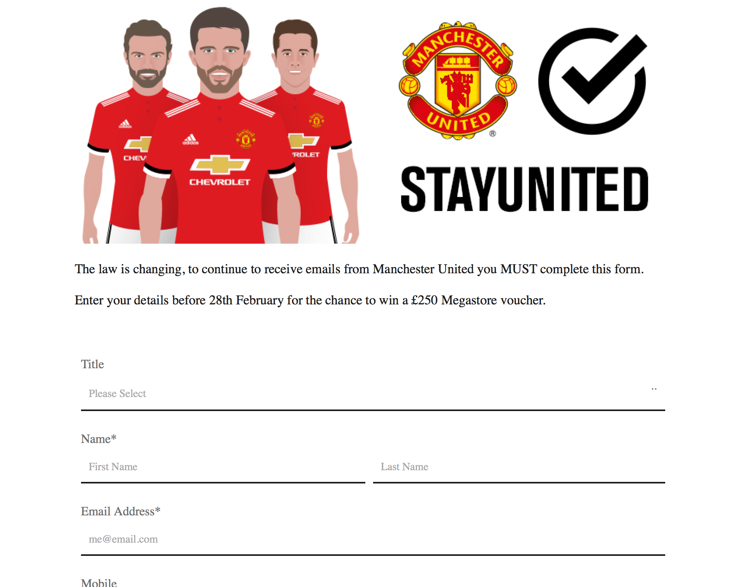
Re-engagement
Holdingbay
For non-active email
No record of opt-in
Warm a subscriber action

Slide 11
Separate Personal Data
Holdingbay
Storage should be encrypted at rest
Data should be secure in transit
Extract personal data to separate and control
Consider Single Sign on system

Slide 12
Export requests
Holdingbay
Develop a process to: Receive customer requests Process personal data to machine format (csv)
Start with just a form and a process, add automation later.
Can not charge for access

Slide 13
Removal requests (forgotten)
Holdingbay
Develop a process to: Receive customer requests Remove personal data Unsubscribe from own automations Unsubscribe from 3rd party email and systems
Keep business record, by anonymising emails
Can not charge for the process

Slide 14
On-going process so bake in Privacy by Design
Holdingbay

Slide 15
Thank you
Holdingbay
Any questions?
Find more here: https://holdingbay.co.uk/gdpr/ https://twitter.com/theholdingbay

